Slide 1
Activation Function
-Activation Summary
-Sigmoid Function
-ReLU Function
Jack Wu

Slide 2
Linear Classifier doesn’t work when…
x[2]
-
Linear features doesn’t work in this case!
+
+1
-
+
0
x[1] AND NOT x[2] OR NOT x[1] AND x[2]
x[1]
0
+1

Slide 3
Activation Function:
Usually non-linear. The Activation Function simulates the Synapse passing down electrical impulses. By adding in an activation function, we will be able to allow the neural network handle complicate tasks.

Slide 4
Keras and TensorFlow supports many activation functions. We will explore two of the most famous ones.
Sigmoid
ReLU

Slide 5
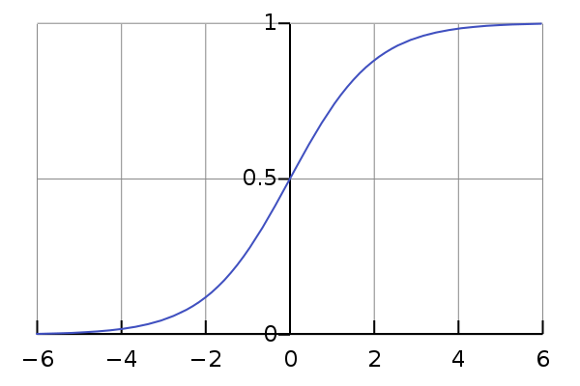
1.
Sigmoid Function
Image Credit: https://en.wikipedia.org/wiki/Sigmoid_function#/media/File:Logistic-curve.svg

Slide 6
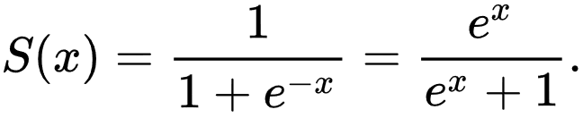
Sigmoid Function
The Neuron will ignore the value of input and will not pass on signal if the value does not meet the threshold value. (When x<5, the output y is 0)
The Neuron starts to pass on signal once the value reaches the threshold value. (In this case, when -5<x<5, the value of y increases as x increases.)
The Neuron becomes less sensitive when the input reaches a certain value. (That is, even with a much larger input, the output slightly changes and value of y approaches to 1).

Slide 7
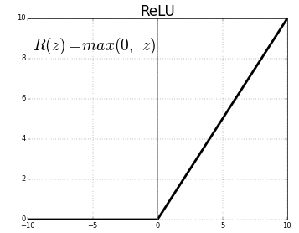
2.
ReLU (Rectified Linear Unit )
Image Credit: https://en.wikipedia.org/wiki/Rectifier_(neural_networks)#/media/File:Rectifier_and_softplus_functions.svg

Slide 8
ReLU
When input x is less than the threshold, the neuron will not pass down the signal. That is, when input x < 0, the output y = 0.
When input x is larger than the threshold, the neuron starts to pass down signal to the next neuron. That is, when input x > 0, output y = x.

Slide 9
Other Activation Functions
Hyperbolic Tangent
Softplus
…

Slide 10
END

